Slide 1


SMART INDIA HACKATHON 2024
Problem Statement ID- SIH1630
Problem Statement Title- Mentor Connect
Theme- Smart Education
PS Category- Software
Team ID- 12929
Team Name- Connexus
Website link: Connexus Website Link
GitHub Repo: GitHub Link
1

Slide 2

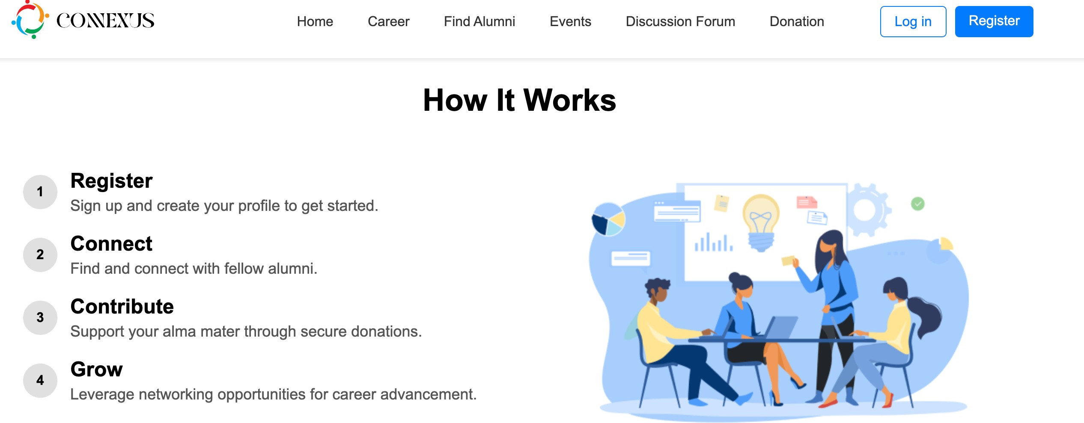
Mentor Connect
Concept and Goal
Primary Goal:
Build a platform to bridge the gap between students and opportunities by offering personalized career guidance and efficient access to offline/virtual events.
Key Deliverables:
Focus on a user-centric interface that is intuitive and accessible for all.
Provide tools and features that encourage participation in events and skill-building activities.
UNIQUENESS :
•
•
•
•
•
Follows MVC architecture for organised code structure. Implements user authentication for secure access.
Includes an emergency donation portal. Allocates points for every user activity. Creates user groups to enhance interaction.

Slide 3
Mentor Connect
Concept and Goal
Objective: Create an impactful platform for personalized career guidance and streamlined student opportunities.
Core Features:-
User-centric interface.
Resourceful tools for offline/virtual event participation.
Easy navigation for all users.
UNIQUENESS :
•
•
•
•
•
Follows MVC architecture for organised code structure. Implements user authentication for secure access.
Includes an emergency donation portal. Allocates points for every user activity. Creates user groups to enhance interaction.

Slide 4
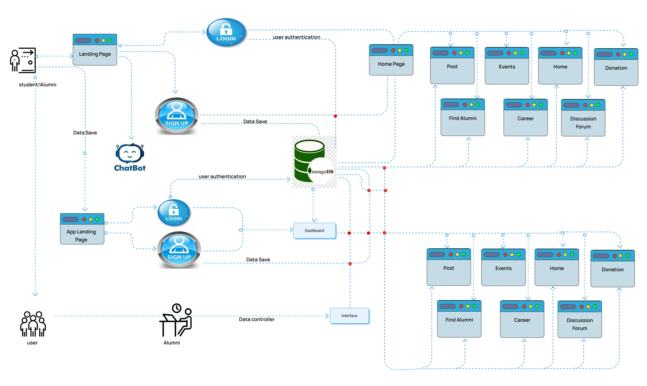
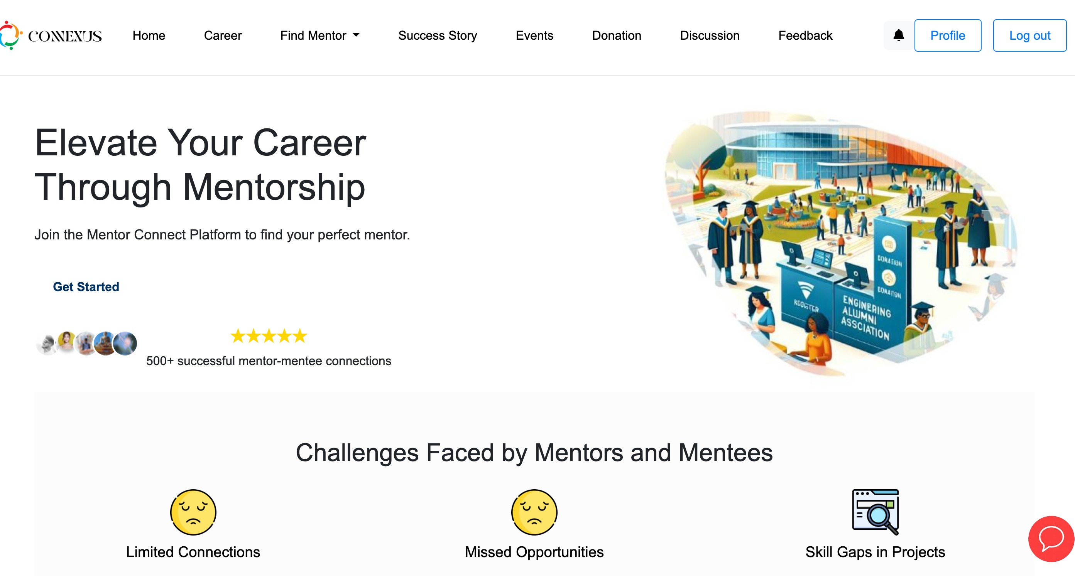













TECHNICAL APPROACH
Technology stacks used :
Render
Frontend
Backend
Database
Host
API & Cloud
App Developme3 nt

Slide 5













FEASIBILITY AND VIABILITY
Web Capabilities
Mobile Compatibility
Cloud Integration
Leverages existing web technologies for an efficient and scalable alumni network association.
Uses modern mobile frameworks (such as Kotlin or Android Studio) to make the app accessible on various devices
Employs cloud services for data storage, processing, and analytics, ensuring real- time performance and scalability to manage growing user data.
Potential Challenges and Solutions
Strategies For Overcoming
need an API to verify an admin's registration or roll number as a college alumnus.
created groups for chat, quizzes & comments on posts to boost interaction.
added a point and reward system to boost user activity.
added a report button and an admin portal to maintain content relevance.
User Engagement & Adoption
Maintaining Content Relevance
Privacy & Security Concerns
Challenges:
Solutions:

Slide 6


IMPACT AND BENEFITS
Stronger Mentor Engagement:
Reconnects mentor, fostering
a lasting community and deepening ties with the institution.
Career Support: Provides a platform for job opportunities, networking, and mentorship, aiding alumni in career growth
Peer Connections:
Groups with shared interests promote collaboration, knowledge exchange, and community-building.
Finding Teammate : Finding skilled teams for each stacks is tough due to high demand and niche expertise
Support for the social cause:
Integrated payment gateway and emergency donation features simplify the contribution process.
Recognition:
The Star Mentor section motivates mentor by highlighting notable achievements.

Slide 7












RESEARCH AND REFERENCES
Scholar Mates: https://www.scholarmates.me/
Mentor connect: https://www.mentorconnect.ca/
IIT Delhi Alumni portal: https://alumni.iitd.ac.in/
Team Members
“Don't let your mentor connections fade into the past! Start building relationships with your mentors today and
Ritesh
join our vibrant Mentor Connect community. Reach out, engage, and unlock new opportunities together!”
Vivek
Rakesh
Connexus
Get Started
Guddu
Ankit
Simran

